Slide 1
Towards Solving Inverse Problems using Physics-Driven Graph Network Simulators
2024 NHERI Computational Academy
Gradient Gurus
Friday, July 26th 2024

Slide 2

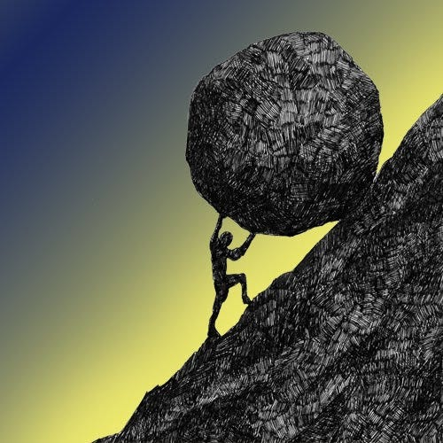



Team Introduction
Team name: Gradient Gurus
James
Xu:
Zul
Kazeem:
Liuyun
(Lulling) Xu:
Kurt
Soncco:
Muhammad
Ali:

Slide 3
Introduction
Problem Statement & Motivation
Methodology
Outline
Results
Conclusions & Appendix
What’s next
Team Contributions

Slide 4

Introduction
Challenges in Structural Health Monitoring
The inverse problem
Computational intensive traditional Methods (e.g., FEA)
Advanced Generalized Approach
More sustainable and resilient structures
Notes:
Structural analysis faces significant challenges in accurately predicting both the state of a structure and its material properties across diverse types and conditions. Traditional methods such as Finite Element Analysis (FEA), Analytical Methods, and Empirical Methods often require extensive retraining and adaptation for each new structural scenario, limiting their efficiency and accuracy. To address these challenges, there is a need for an advanced approach that can seamlessly handle various structural types and loading conditions. This will enhance efficiency, accuracy, and ease of structural health monitoring, contributing to more sustainable and resilient structures.

Slide 5
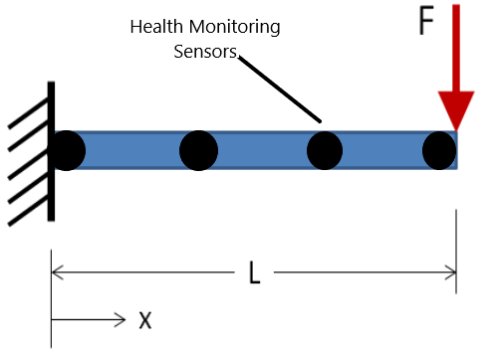
Problem Statement and Case Study
Engineers utilize health monitoring systems to understand the real-time behavior of structures:
Deflection
Cracking
Deterioration
The sensors are distributed strategically to capture the behavior of the element.
We considered a simple cantilever beam with a point load at the cantilever end.
The nodes are considered as the health monitoring sensors were our target would be to calculate the deflection values of the beam at these nodes.

Slide 6
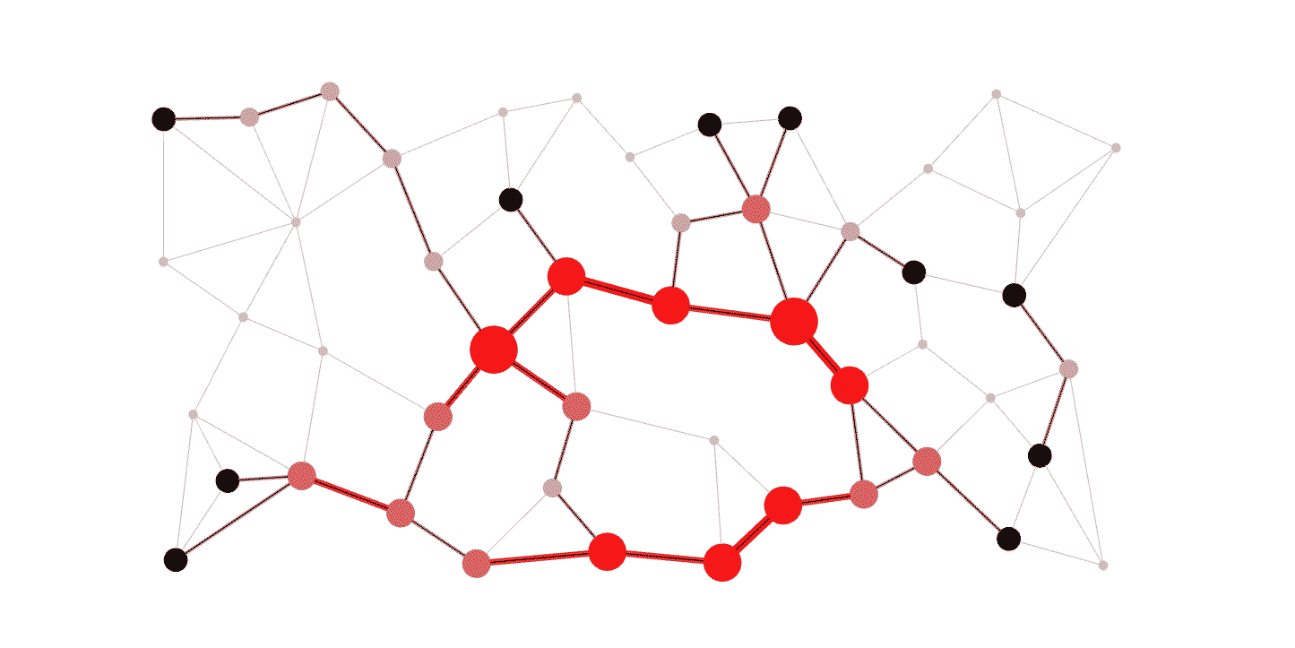
Methodology
Generate deflection data for cantilever beam under different force magnitudes using OpenseesPy
Develop a data driven GNS to reproduce the deflection of the beam
Develop a physics-informed GNS to predict more accurate deflection and also stiffness of the beam compared to the data driven one

Slide 7





Software Used
OpenSees through Design Safe
Google Colab
Jupyter notebook through Design Safe
GitHub
GPU allocation in TACC

Slide 8
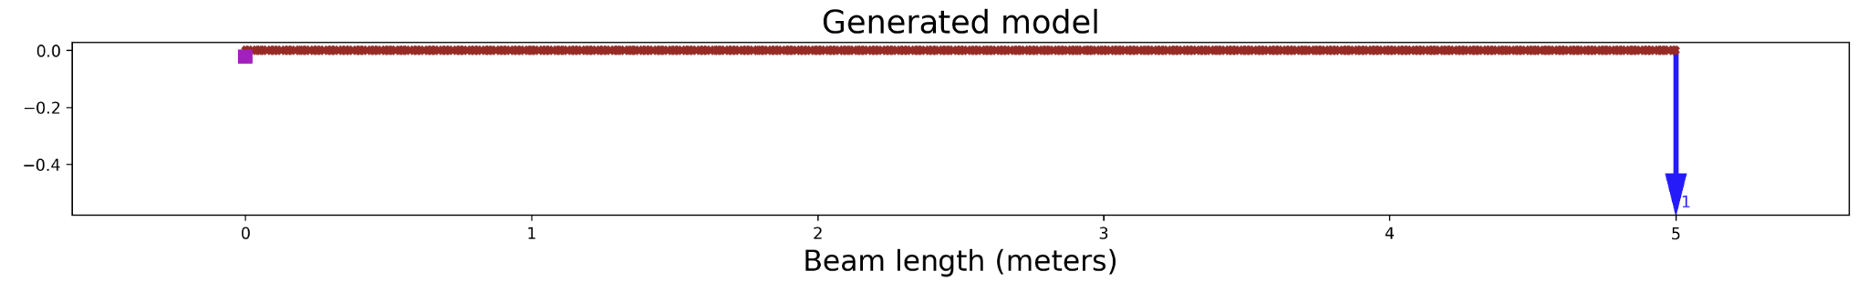
Data Generation
Finite Element Modeling
Fiber-based Steel Cantilever Beam Model in OpenSeesPy
Linear Material Model
Static Loading

Slide 9
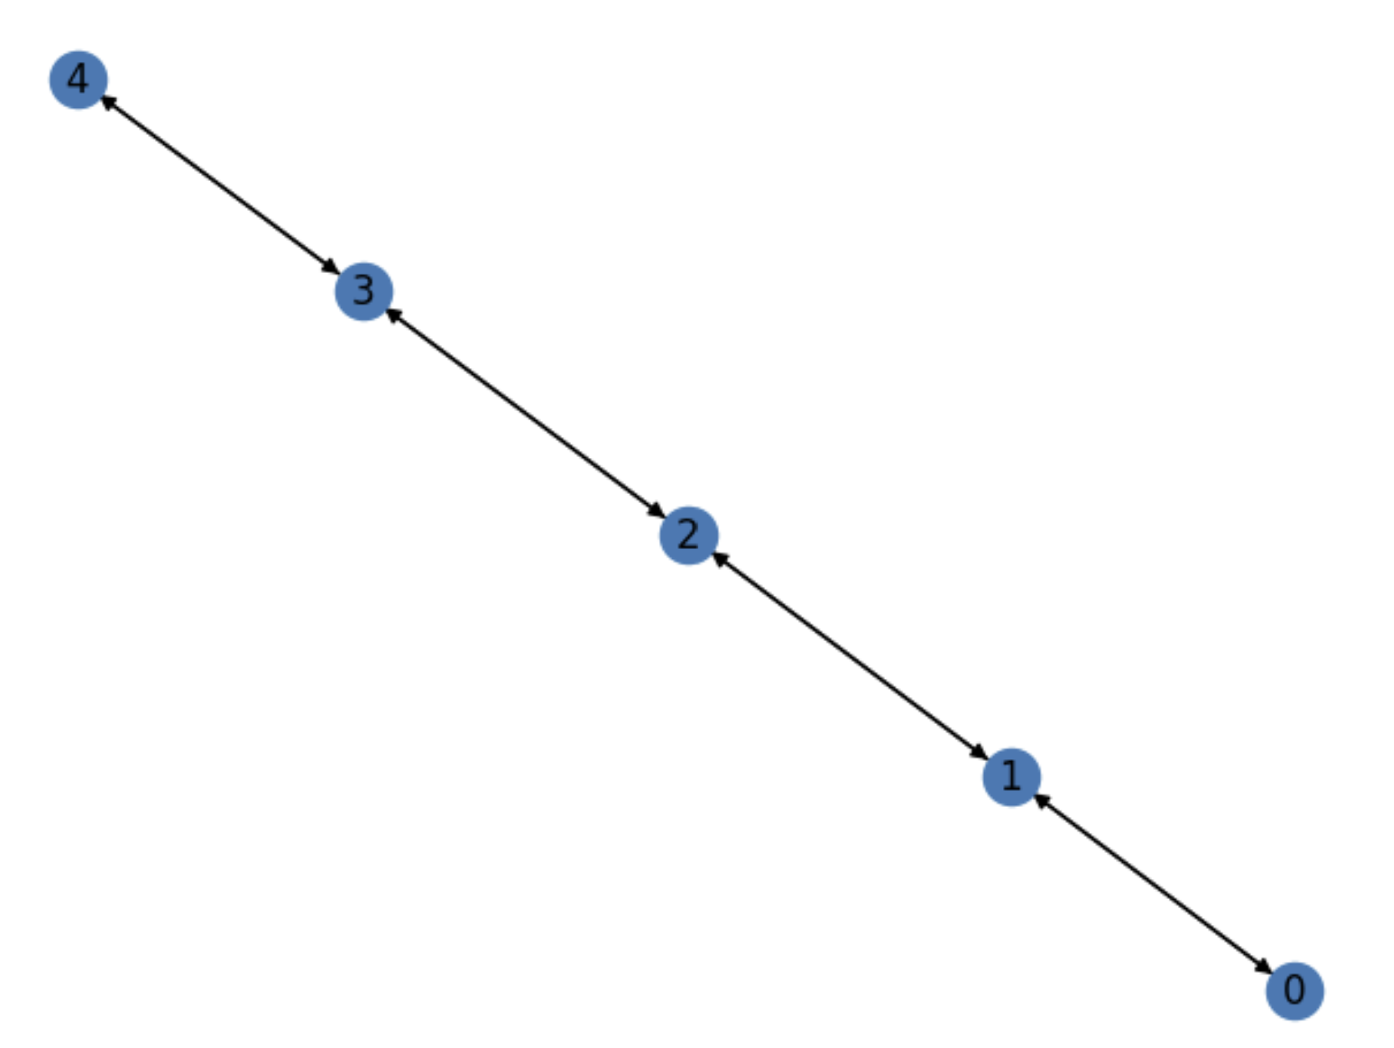
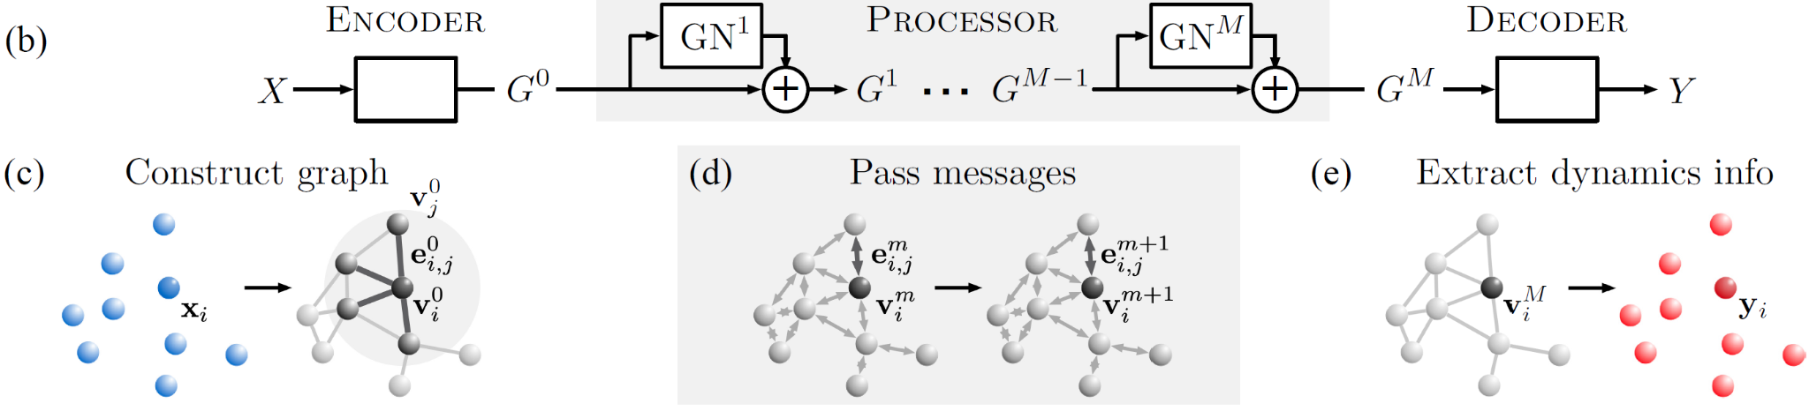
Graph Network Simulator
Edge Creation by radius
End to End GNN Training Scheme
Predict deflection, loading, and flexural rigidity through minimizing data loss

Slide 10
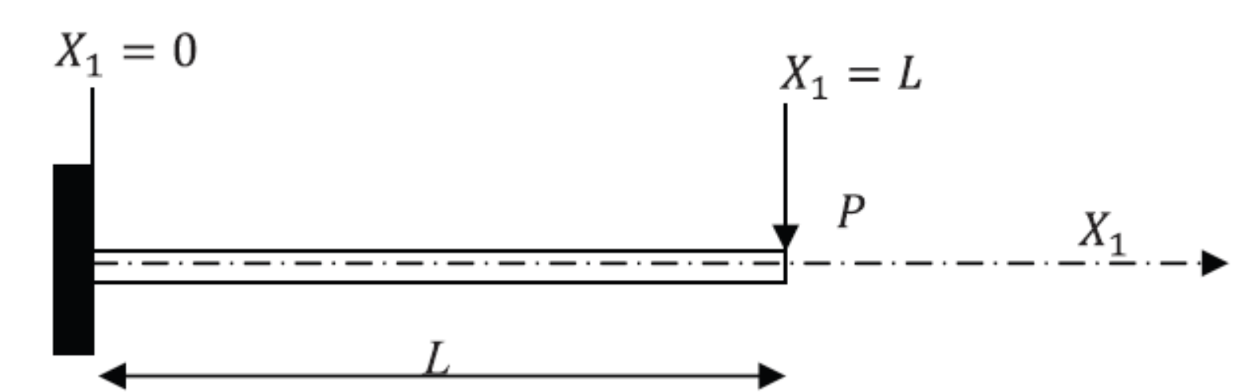
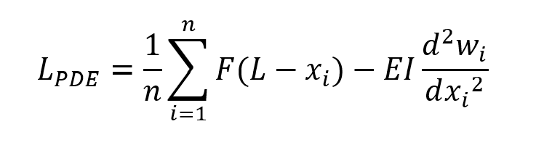
Physics Loss
Ordinary/Partial Differential Equation
Predict stiffness through minimizing physics and pde loss
Predict loading through minimizing pde loss
Predict flexural rigidity through minimizing pde loss
Notes:
Structural analysis faces significant challenges in accurately predicting both the state of a structure and its material properties across diverse types and conditions. Traditional methods such as Finite Element Analysis (FEA), Analytical Methods, and Empirical Methods often require extensive retraining and adaptation for each new structural scenario, limiting their efficiency and accuracy. To address these challenges, there is a need for an advanced approach that can seamlessly handle various structural types and loading conditions. This will enhance efficiency, accuracy, and ease of structural health monitoring, contributing to more sustainable and resilient structures.

Slide 11
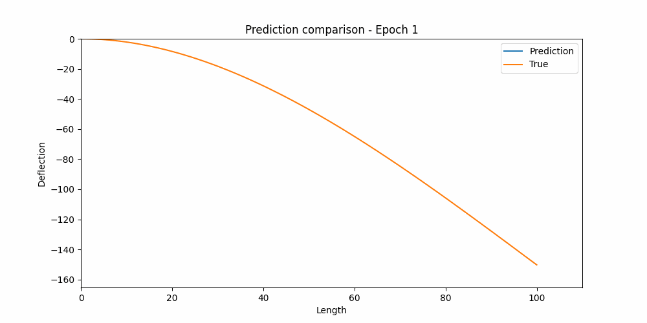
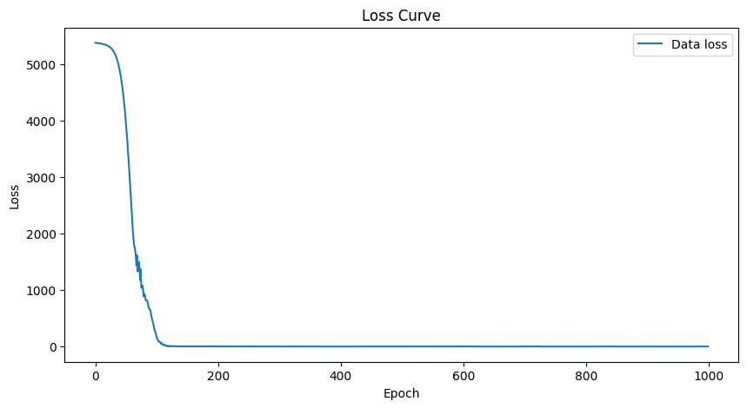
Results
Pure Data-driven Predictions

Slide 12
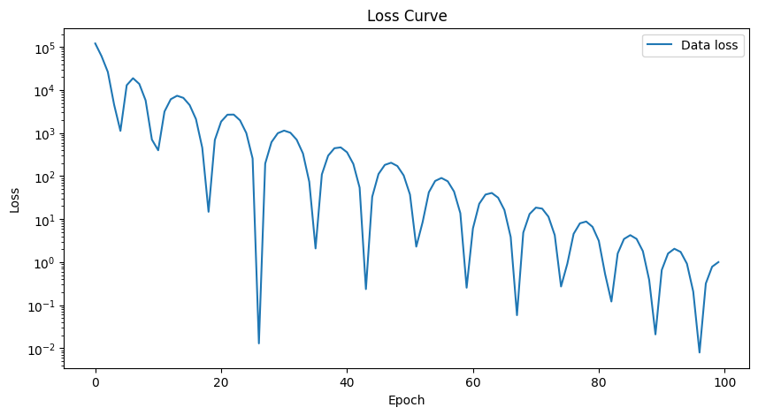
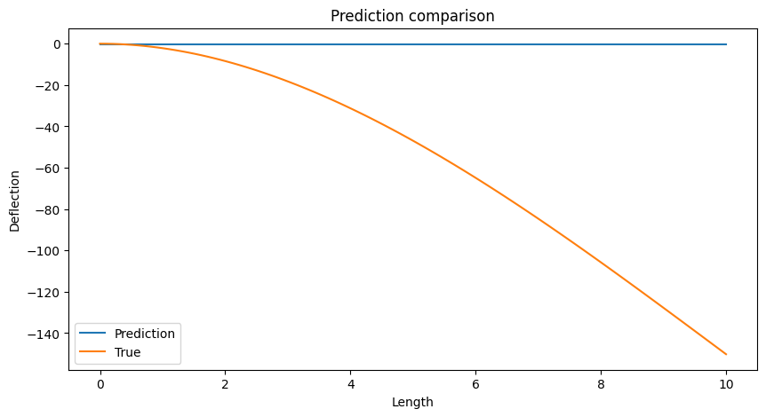
Results
PDE-driven Predictions
Characterizing possible failure modes in physics-informed neural networks
Krishnapriyan et al.
https://arxiv.org/abs/2109.01050

Slide 13
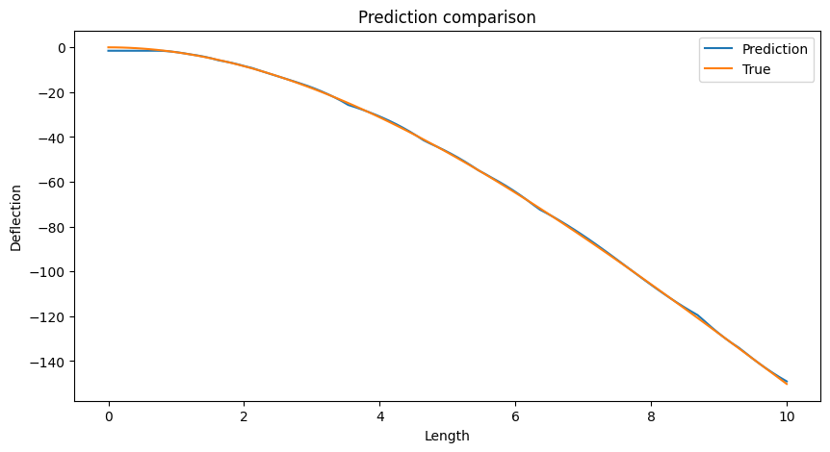
Results
PDE + Data driven solution?

Slide 14
Conclusion
Physics-informed Graph Network Simulator (GNS): By integrating physical laws with advanced graph network techniques, the GNS simulates the behavior of cantilever beams under varying loads and lengths.
High Accuracy and Computational Efficiency: The results from the simulator have shown high accuracy in reproducing the structural responses.
Physics information Prediction: By incorporating the physics laws, GNS is capable of predicting the structural properties such as stiffness.

Slide 15
What’s next?
Moving on from toy problems: Extend the simulator to address dynamic problems, to make it an efficient tool for predicting the time-varying structural behavior.
Compare with gradient free optimization methods in time and accuracy performance
Utilizing Real-World Data: Integrate real-world data from sensors to improve the accuracy and applicability of simulations, moving beyond simulated data to better reflect actual conditions.
Expanding to Different Structural Types: Train the GNS to handle various structural types with minimal additional training required to improve generalization.
Training heuristics: Using some strategies such as different optimizers and learning rate schedulers to speed up training.

Slide 16
Project Team and Contributions
James Xu: He was responsible for data generation using OpenSeespy, as well as model building, training, and testing with the GNS.
Kurt Soncco: He was responsible for model building, training, and testing with the Graph Network Simulator, as well as conducting the literature review.
Liuyun Xu: She worked on data generation using OpenSeespy, prepared the presentation slides, as well as helped with the model building.
Muhammad Ali: He worked alongside others for the model building, as well as prepared the presentation slides.
Zul Kazeem: She helped with data preprocessing, slide preparation, as well as code documentation.

Slide 17
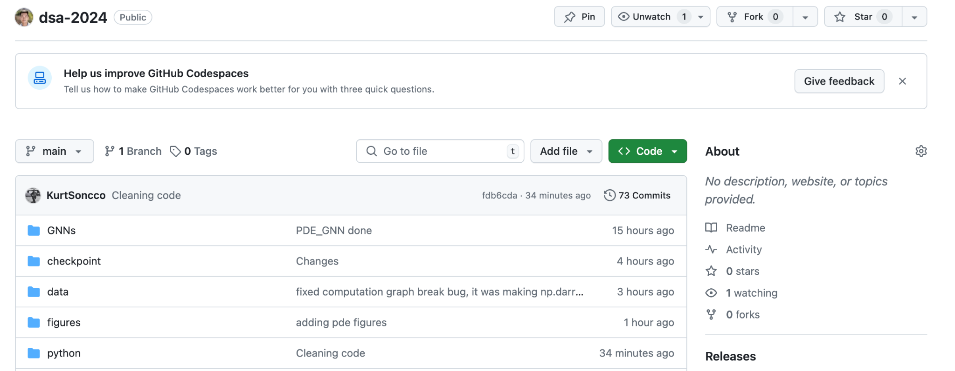
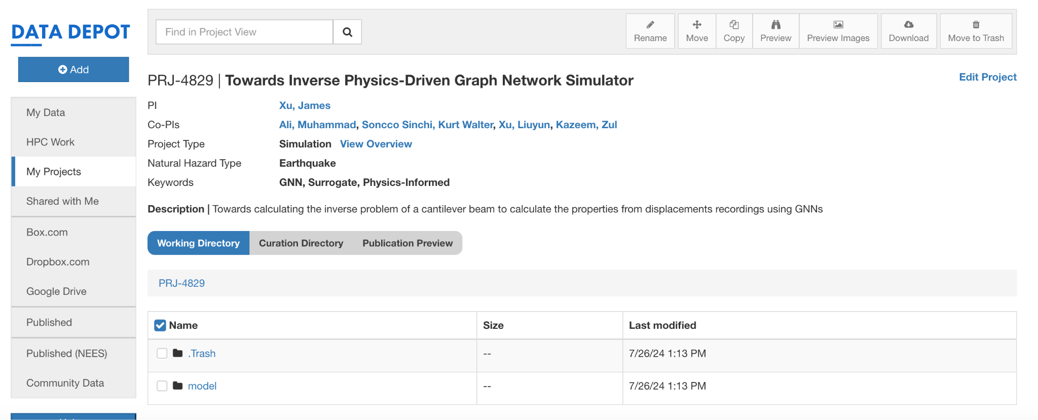
Appendix
All codes are available on Github at https://github.com/jamesterryxu/dsa-2024
Project is uploaded in DesignSafe as: PRJ-4829 | Towards Inverse Physics-Driven Graph Network Simulator (Data Depot | DesignSafe-CI)
Proper Code documentation to ensure reusability and reproducibility as can be seen at https://github.com/jamesterryxu/dsa-2024/blob/main/Copy_of_gns_colab_ZK.ipynb
Notebook can be easily run on Google Colab

Slide 18
References
Li, Q., Wang, Z., Li, L., Hao, H., Chen, W., & Shao, Y. (2023). Machine learning prediction of structural dynamic responses using graph neural networks. Computers & Structures, 289, 107188.
Godwin, J., Pfaff, T., Ying, R., Leskovec, J., & Battaglia, P. W. (2020). Learning to Simulate Complex Physics with Graph Networks. ArXiv. /abs/2002.09405
Fogang, V. Euler-Bernoulli Beam Theory: First-Order Analysis, Second-Order Analysis, Stability, and Vibration Analysis Using the Finite Difference Method. Preprints 2021, 2021020559. https://doi.org/10.20944/preprints202102.0559.v2

Slide 19
Acknowledgment
University of Texas Advanced Computing Center
Professor Somdatta Goswami
Professor Krishna Kumar
Cheng-Hsi Hsiao

Slide 20

Questions
Thank You

